Slide 1
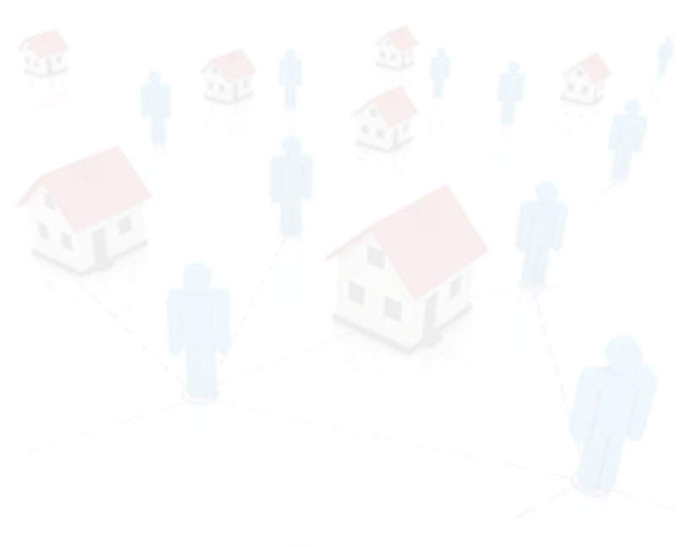


Nation of Neighbors
PJ Rey
University of Maryland pjrey.socy@gmail.com
PJ Rey (@pjrey)

Slide 2
Nation of Neighbors:
PJ Rey (@pjrey)

Slide 3
Nation of Neighbors:
Background
PJ Rey (@pjrey)

Slide 4
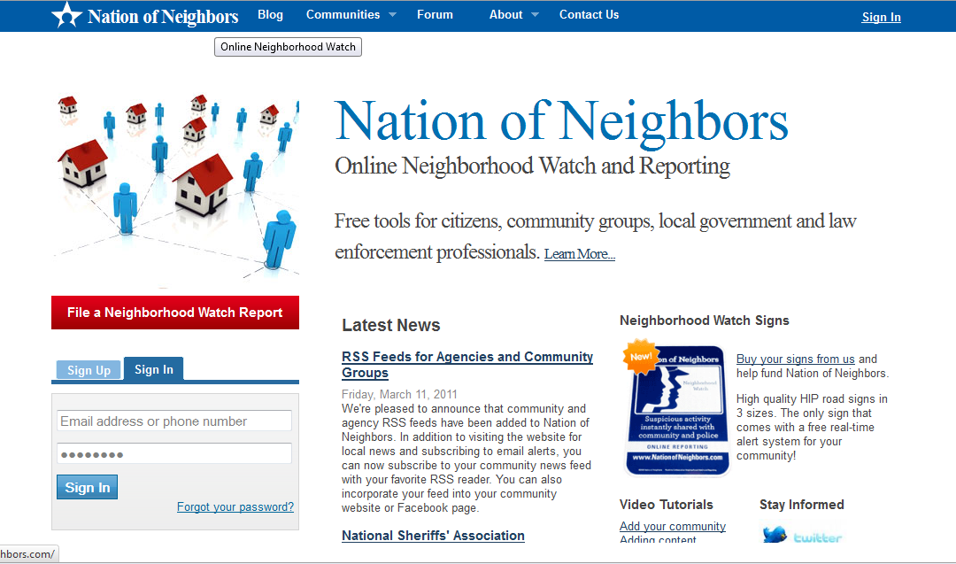
Nation of Neighbors
PJ Rey (@pjrey)

Slide 5
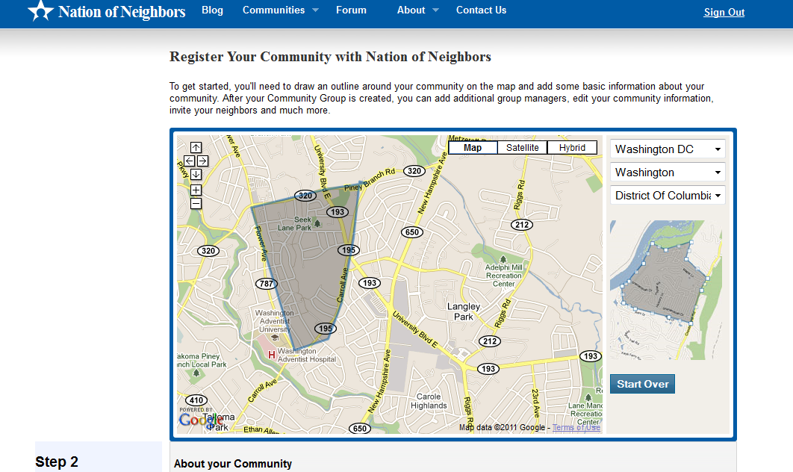
Registering a Community
PJ Rey (@pjrey)

Slide 6
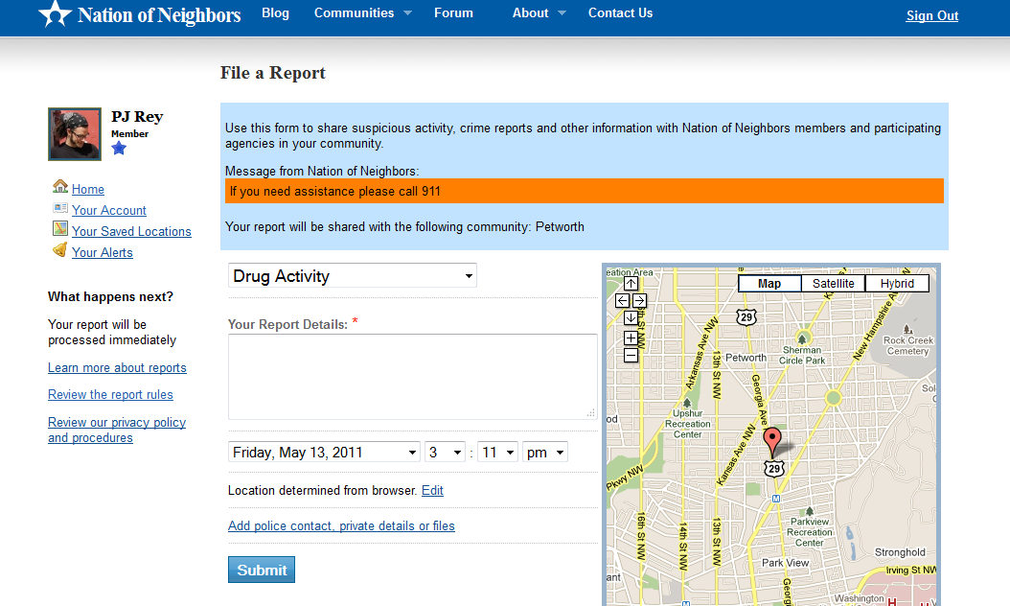
Filing Reports
PJ Rey (@pjrey)

Slide 7
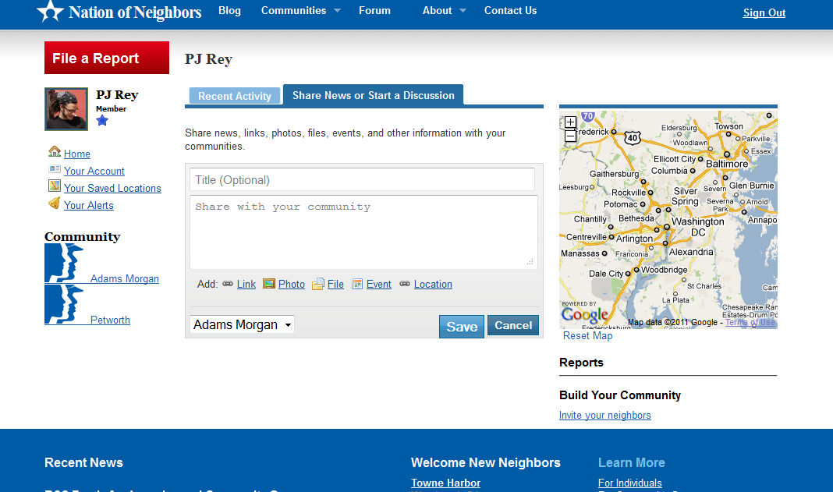
Posting Comments
PJ Rey (@pjrey)

Slide 8
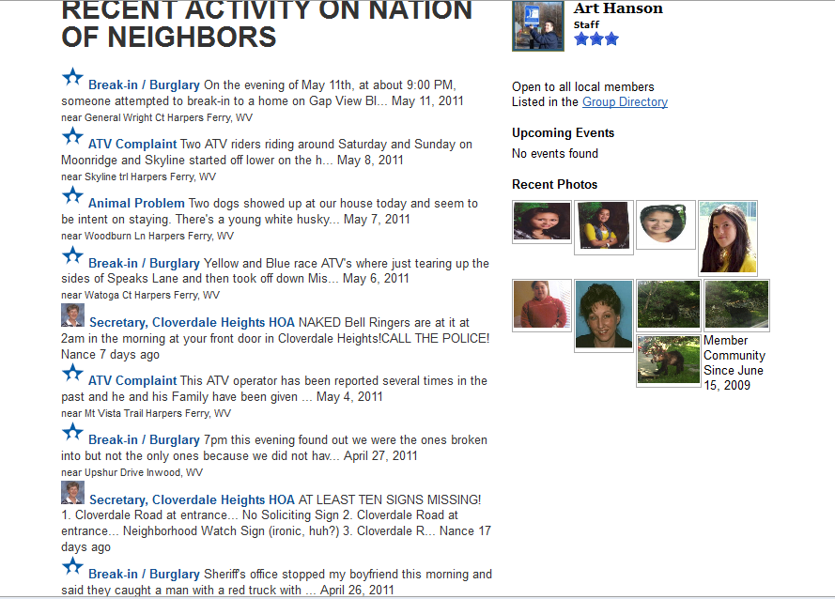
Conversation Feed
PJ Rey (@pjrey)

Slide 9
Nation of Neighbors:
PJ Rey (@pjrey)

Slide 10
Nation of Neighbors:
User Motivations
PJ Rey (@pjrey)

Slide 11
Invitation Experiment
Four motivations for community involvement:
  Egoism: benefit one-self
  Altruism: benefit one or more other individuals
  Collectivism: to benefit a group
  Princliplism: to uphold moral principles
  Batson, et al., 2002
PJ Rey (@pjrey)

Slide 12
Invitation Experiment
Results
  Control: 27.3% acceptance
  Egoism: 36.8% acceptance
  Altruism: 41.9% acceptance*
  Collectivism: 28.26% acceptance
  Princliplism: 29.03% acceptance
  difference significant at p ≤.01
PJ Rey (@pjrey)

Slide 13
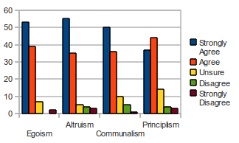
Survey
PJ Rey (@pjrey)

Slide 14
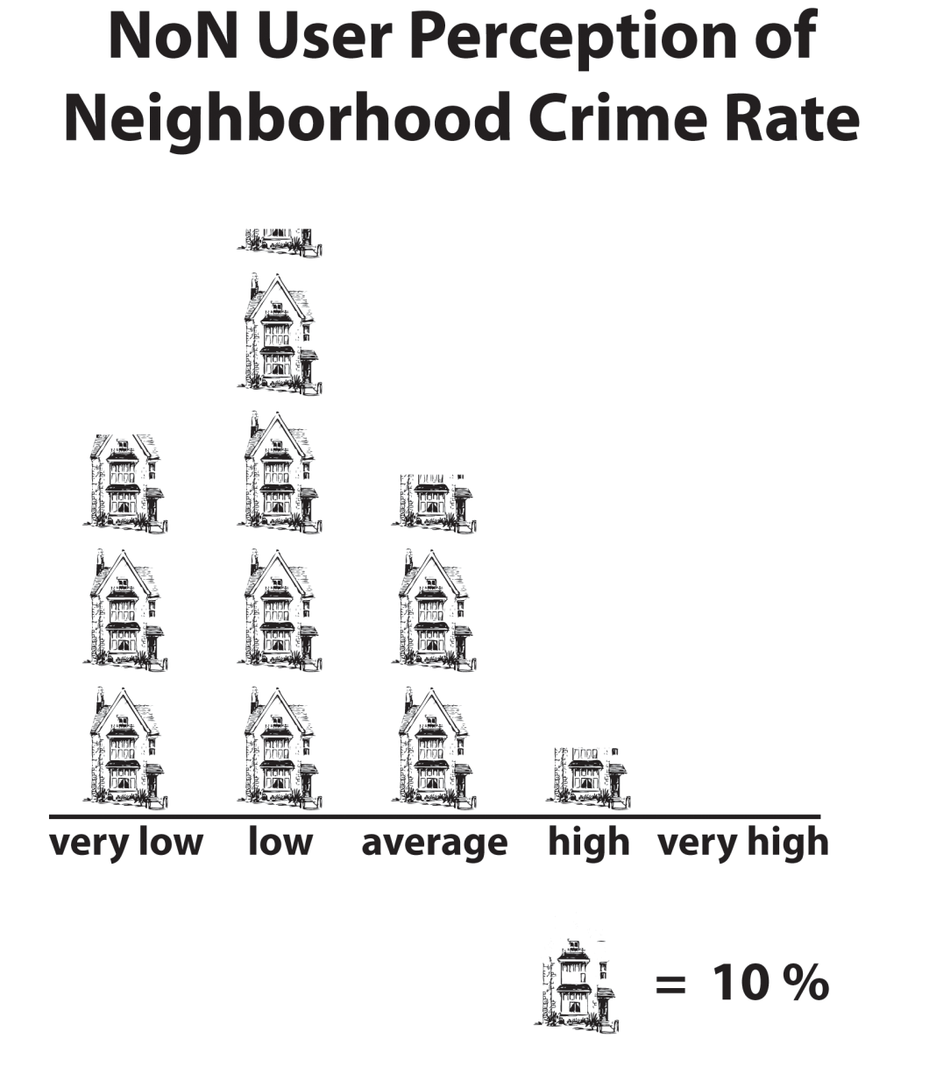
Survey
PJ Rey (@pjrey)

Slide 15
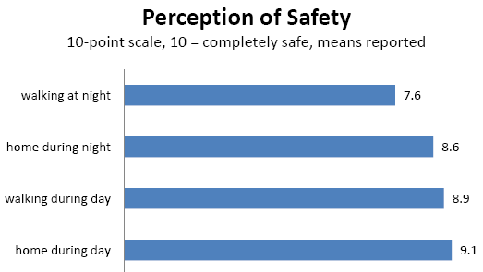
Survey
PJ Rey (@pjrey)

Slide 16
Nation of Neighbors:
PJ Rey (@pjrey)

Slide 17
Nation of Neighbors:
Evaluating Success
PJ Rey (@pjrey)

Slide 18
Developed vs. Developing Communities
different goals:
developed communities – primarily oriented toward building/maintaining/utilizing capacity through regular communication
developing communities – primarily oriented toward growth of membership through sending invitations
PJ Rey (@pjrey)

Slide 19
Defining Health
Health is communications activity that is appropriate, both in kind and degree, to the needs of a community in its particular stage of development.
PJ Rey (@pjrey)

Slide 20
Activity Measures
reports
posts
replies
invitation emails sent
invitation acceptances
PJ Rey (@pjrey)

Slide 21
Future Work
… will attempt to determine whether the following contribute (either positively or negatively) to the health of online crime-prevention communities:
law enforcement involvement
perceptions of community safety
impressions of community efficacy
technological literacy
PJ Rey (@pjrey)

Slide 22
Take Away
Social media → new opportunities for community crime prevention
Nation of Neighbors = ½ neighborhood crime watch, ½ community of practice
Evaluating success requires:
    new measures
    new tools
Through this work, we expect to learn more about important factors influencing the development of healthy online communities.
PJ Rey (@pjrey)

Slide 23

PJ Rey pjrey.socy@gmail.com
This material is based upon work supported in part by the
National Science Foundation
Grant # IIS - 0968521
PJ Rey (@pjrey)

